Slide 1
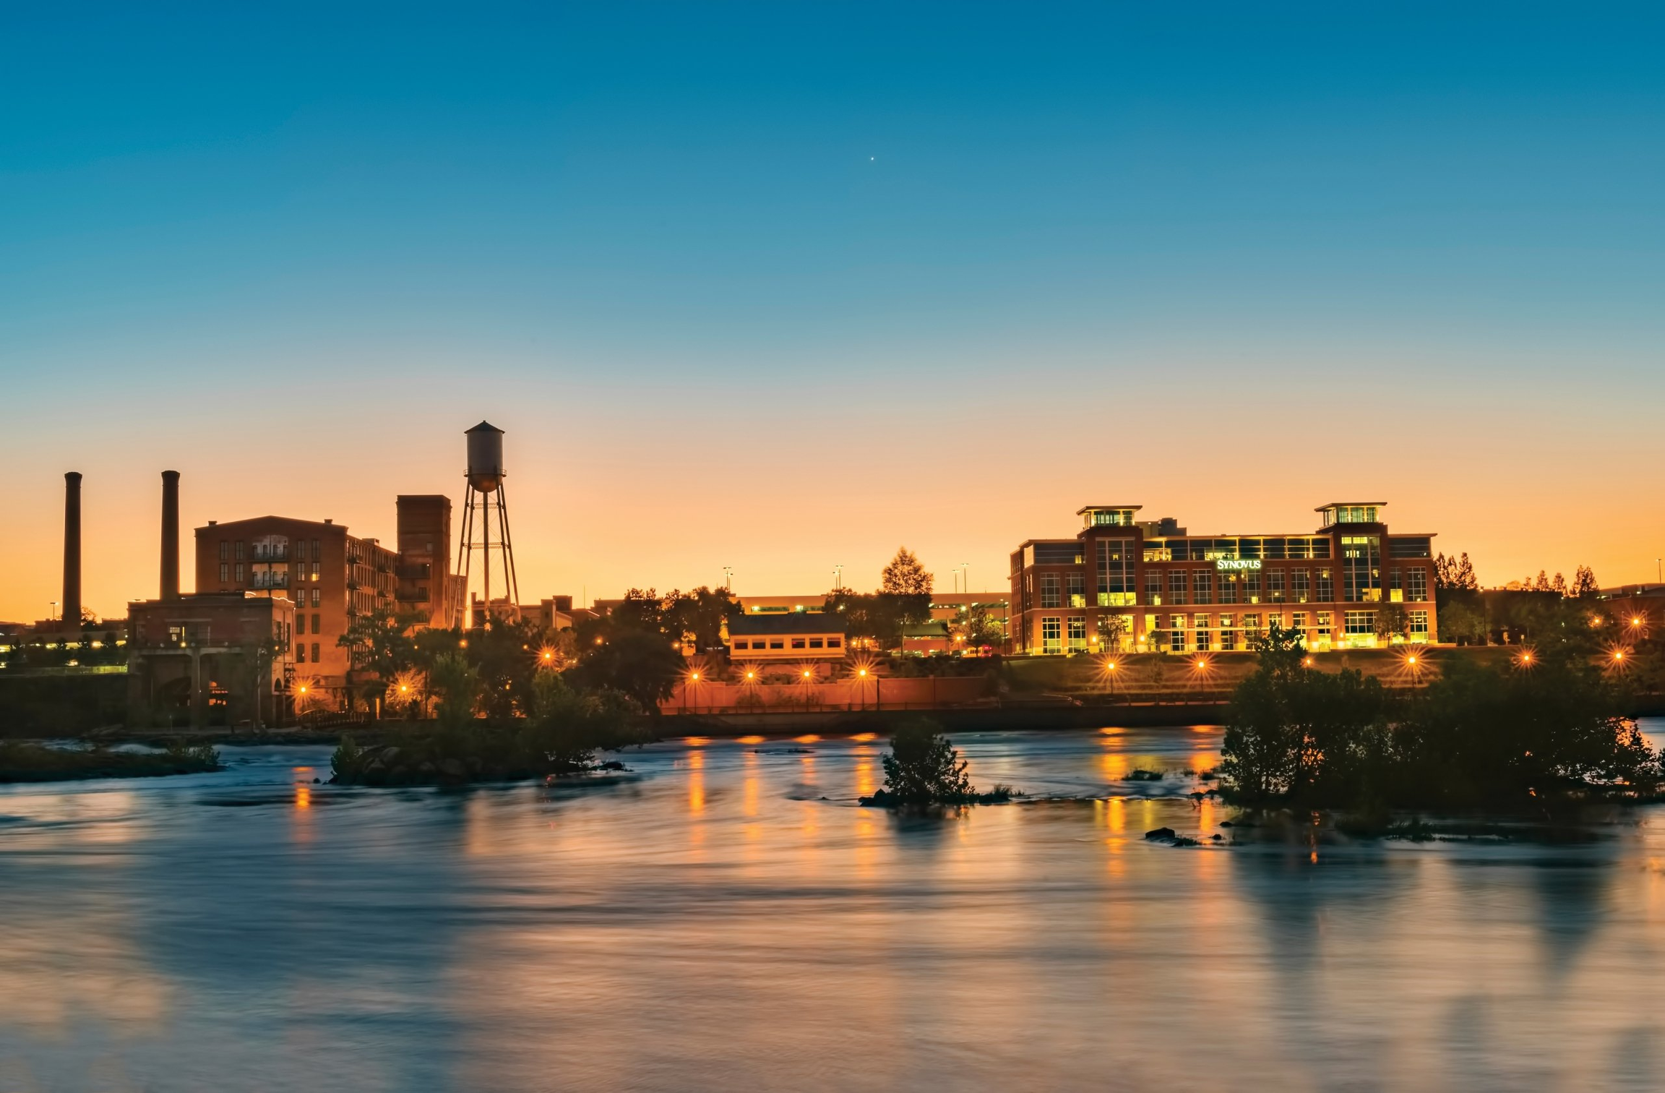


FROM BOTTLE NECKS TO BREAKTHROUGHS
A First‑Ready, First‑Out Model for CDBG Project Selection
COMMUNITY
REINVESTMENT

Slide 2
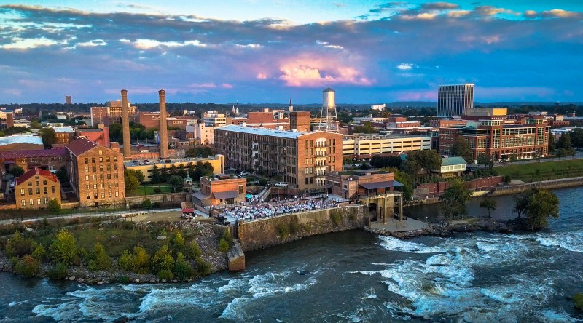
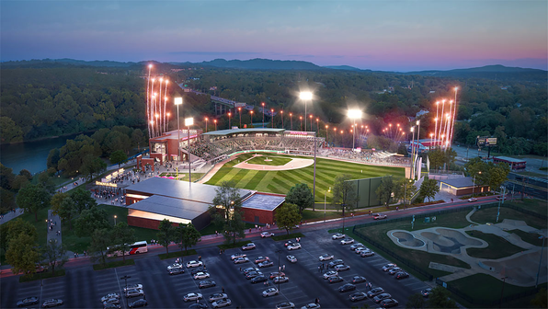

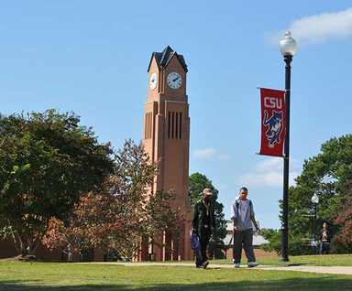
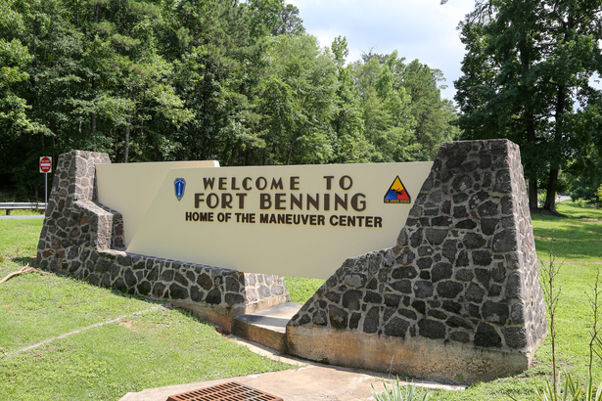
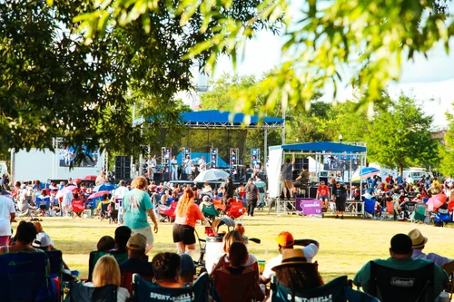
COLUMBUS, GA DEMOGRAPHY
2nd largest City in the State of Georgia: 201,830
The Three Largest Racial/Ethnic Groups (2024):
-47% Black or African American alone (Non-Hispanic)
-38.1% White alone (Non-Hispanic)
-8.5% Hispanic or Latino
Median Household Income: $58,073
Persons in Poverty: 19%
Bachelor's Degree or Higher: 30.5%
Midsize Entitlement Community: Receives CDBG, HOME, and ESG
COMMUNITY
REINVESTMENT

Slide 3
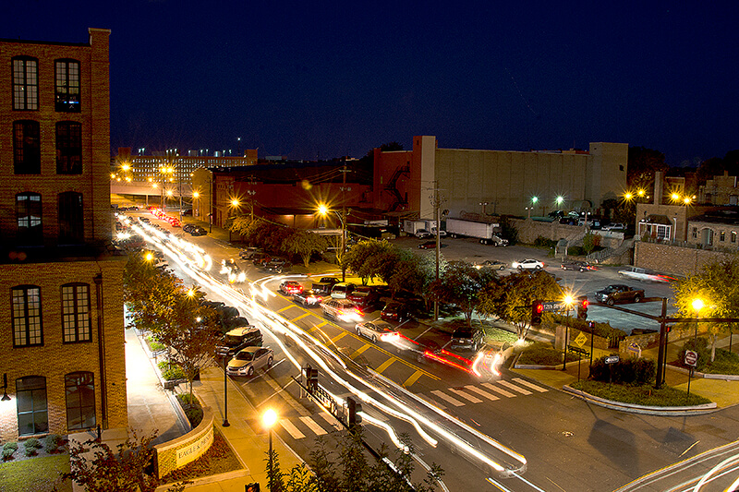
THE COMMON CDBG PITFALL
Projects funded before they are ready to move
Environmental, design, or site control delays
Funds awarded but not expended
COMMUNITY
REINVESTMENT

Slide 4
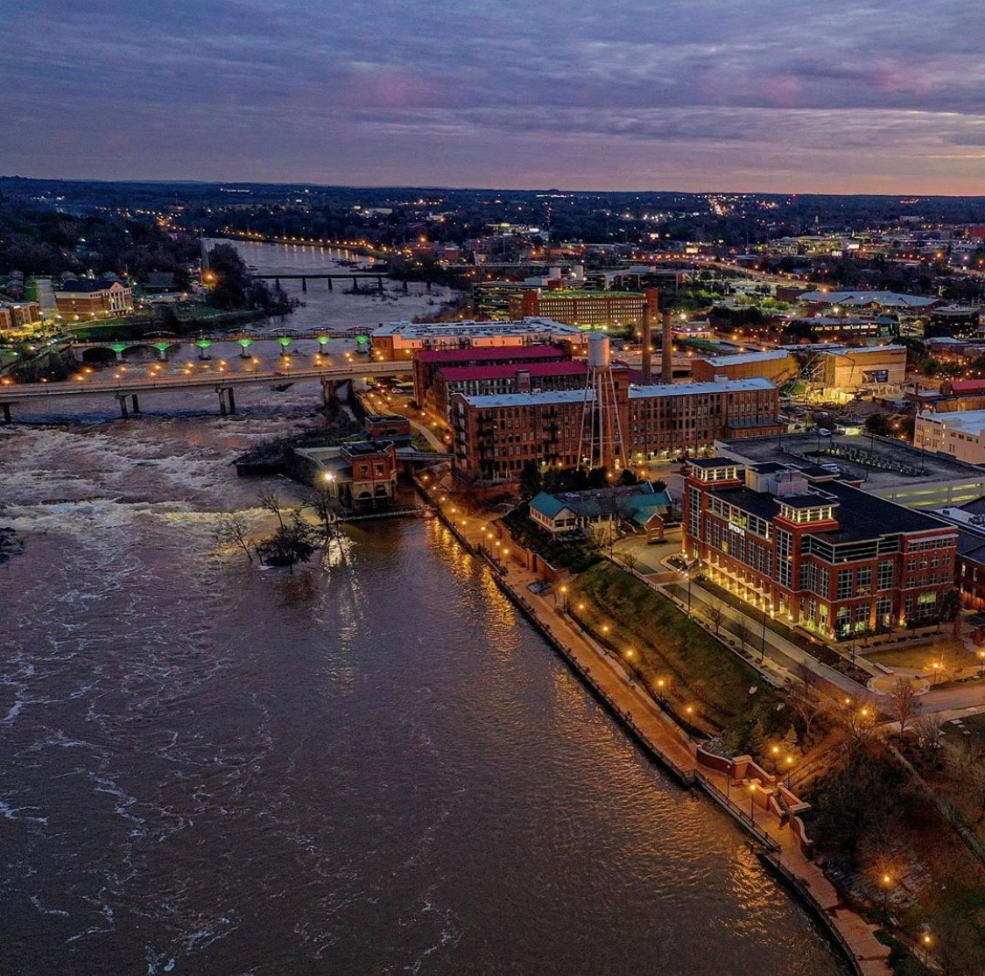
WHY THIS BECOMES A SERIOUS PROBLEM
Staff time shifts to managing delays
Multiple projects stall at once
CDBG balances grow instead of shrinking
COMMUNITY
REINVESTMENT

Slide 5
THE DIRECT IMPACT ON OUR CITY
•Timeliness ratio under pressure
•Limited ability to reprogram funds
•Fewer visible community outcomes
COMMUNITY
REINVESTMENT

Slide 6


THE REALIZATION
•Good projects are not always ready projects
•Funding decisions must align with implementation capacity
•Timeliness is a systems issue, not a spending issue
COMMUNITY
REINVESTMENT

Slide 7
FIRST‑READY, FIRST‑OUT MODEL
Projects advance when benchmarks are met
First ready project is first funded
Continuous flow of implementation
COMMUNITY
REINVESTMENT

Slide 8
THE PROJECT PIPELINE
Projects not ready are not rejected
They enter a structured readiness pipeline
Funding follows readiness, not hope
COMMUNITY
REINVESTMENT

Slide 9
BUILDING A STRATEGIC FUNDING SYSTEM
•Defined readiness benchmarks
•Standardized pre‑award requirements
•Intentional sequencing of projects
COMMUNITY
REINVESTMENT

Slide 10
RESULTS & KEY TAKEAWAY
•Improved CDBG timeliness
•Faster project starts
•Readiness is a strategy, not a barrier
COMMUNITY
REINVESTMENT

Slide 11

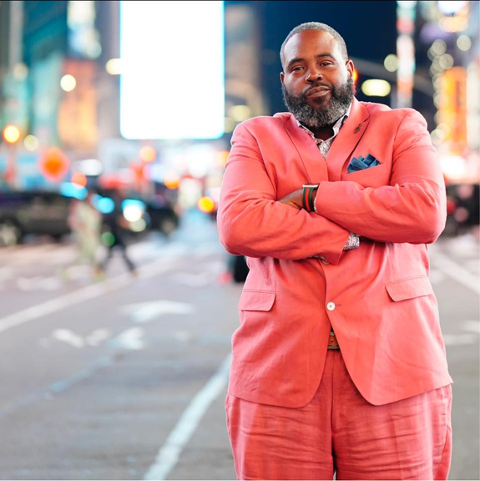

ROBERT SCOTT
Director, Community Reinvestment
COMMUNITY
REINVESTMENT

Slide 12
THANK YOU
&
QUESTIONS?
COMMUNITY
REINVESTMENT

